Slide 1
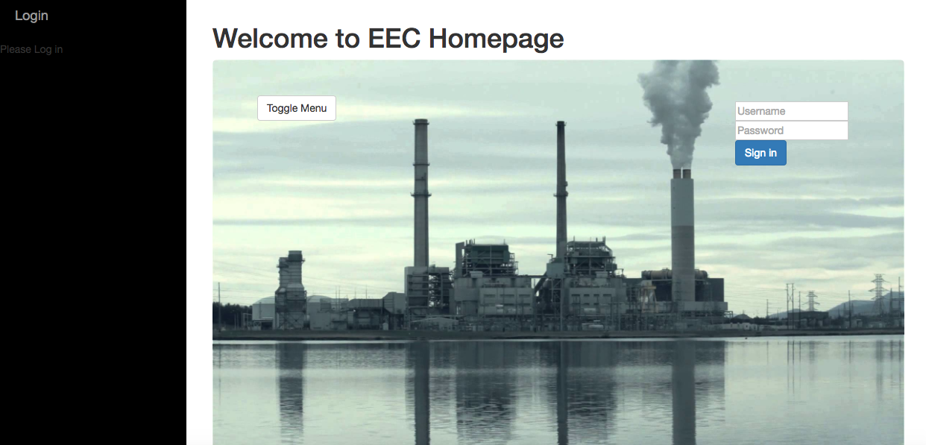
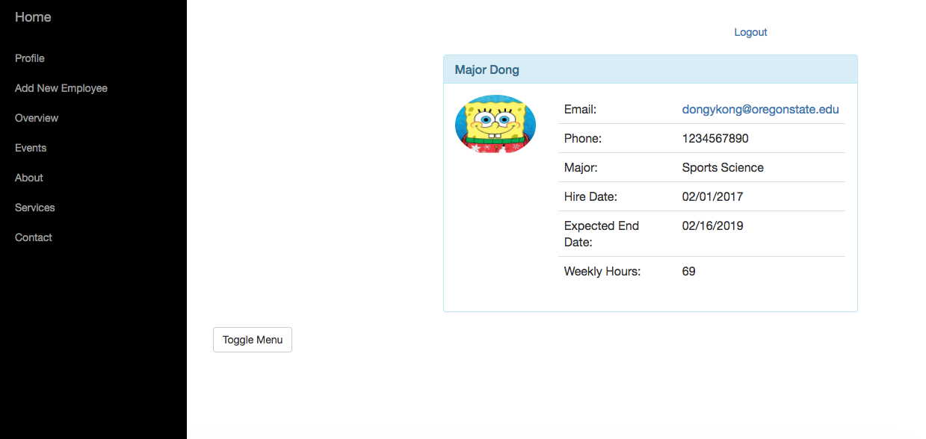
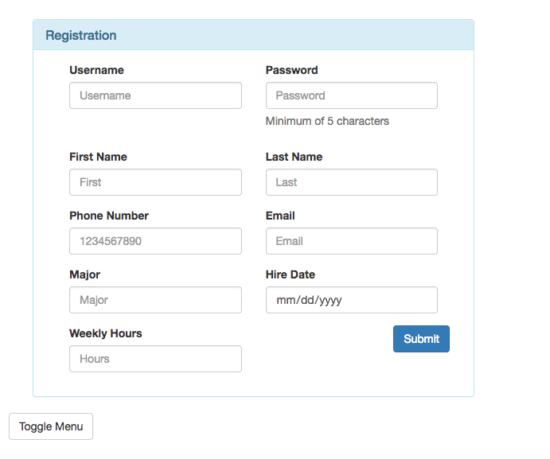
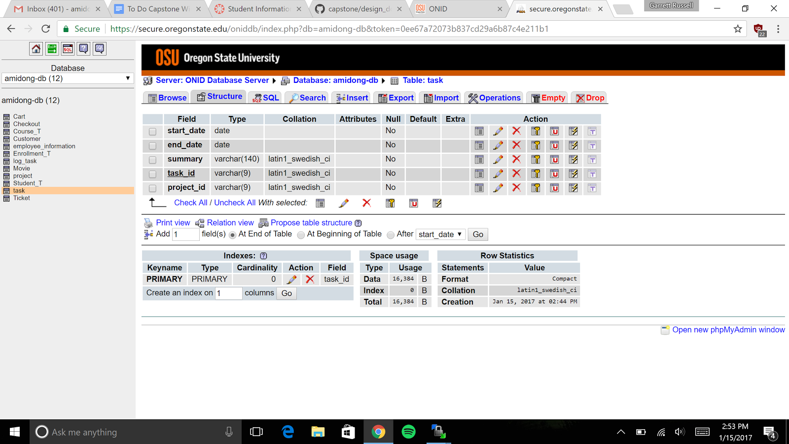
EEC: Energy efficiency center
Energy Efficiency Center
Garrett, James, Kanna
OSU’s Energy Efficiency Center help manufacturing and industrial companies increase their productivity and reduce their energy footprint by producing reports for energy and productivity recommendations. These reports, projects and funds are maintained in their website. The website has been developed and maintained by several programmers. As a result, the website has become disorganized, difficult to update and use. In order to remedy these issues we will design a secure, user friendly website with good code practices for the Energy Efficiency Center. Furthermore, the website is not accessible from mobile devices which decreases productivity of workers who can’t access the website while on the job site. We aim to create a secure mobile app for the client which they are able to remotely access.
accessible from mobile devices which decreases productivity of workers who can’t access the website while on the job site. We aim to create a secure mobile app for the client which they are able to remotely access.
Methods
Tools
OSU’s Energy Efficiency Center help manufacturing and industrial companies increase their productivity and reduce their energy footprint by producing reports for energy and productivity recommendations. These reports, projects and funds are maintained in their website. The website has been developed and maintained by several programmers. As a result, the website has become disorganized, difficult to update and use. In order to remedy these issues we will design a secure, user friendly website with good code practices for the Energy Efficiency Center. Furthermore, the website is not accessible from mobile devices which decreases productivity of workers who can’t access the website while on the job site. We aim to create a secure mobile app for the client which they are able to remotely access.
OSU’s Energy Efficiency Center help manufacturing and industrial companies increase their productivity and reduce their energy footprint by producing reports for energy and productivity recommendations. These reports, projects and funds are maintained in their website. The website has been developed and maintained by several programmers. As a result, the website has become disorganized, difficult to update and use. In order to remedy these issues we will design a secure, user friendly website with good code practices for the Energy Efficiency Center. Furthermore, the website is not accessible from mobile devices which decreases productivity of workers who can’t access the website while on the job site. We aim to create a secure mobile app for the client which they are able to remotely access.
Analysis
OSU’s Energy Efficiency Center help manufacturing and industrial companies increase their productivity and reduce their energy footprint by producing reports for energy and productivity recommendations. These reports, projects and funds are maintained in their website. The website has been developed and maintained by several programmers. As a result, the website has become disorganized, difficult to update and use. In order to remedy these issues we will design a secure, user friendly website with good code practices for the Energy Efficiency Center. Furthermore, the website is not accessible from mobile devices which decreases productivity of workers who can’t access the website while on the job site. We aim to create a secure mobile app for the client which they are able to remotely access
OSU’s Energy Efficiency Center help manufacturing and industrial companies increase their productivity and reduce their energy footprint by producing reports for energy and productivity recommendations. These reports, projects and funds are maintained in their website. The website has been developed and maintained by several programmers. As a result, the website has become disorganized, difficult to update and use. In order to remedy these issues we will design a secure, user friendly website with good code practices for the Energy Efficiency Center. Furthermore, the website is not accessible from mobile devices which decreases productivity of workers who can’t access the website while on the job site. We aim to create a secure mobile app for the client which they are able to remotely access.
.
Features
OSU’s Energy Efficiency Center help manufacturing and industrial companies increase their productivity and reduce their energy footprint by producing reports for energy and productivity recommendations. These reports, projects and funds are maintained in their website. The website has been developed and maintained by several programmers. As a result, the website has become disorganized, difficult to update and use. In order to remedy these issues we will design a secure, user friendly website with good code practices for the Energy Efficiency Center. Furthermore, the website is not accessible from mobile devices which decreases productivity of workers who can’t access the website while on the job site. We aim to create a secure mobile app for the client which they are able to remotely access.
OSU’s Energy Efficiency Center help manufacturing and industrial companies increase their productivity and reduce their energy footprint by producing reports for energy and productivity recommendations. These reports, projects and funds are maintained in their website. The website
Notes:
If tri-fold mounting at SMS – make sure no text or image is in-between the two vertical guide lines; this space will be cut away. To view the vertical guide lines: Select “View” from the main menu, select “Guides” from the pull down menu, and lastly select “Static Guides”.

